Slide 1

Author's rights to IP objects
Copyright
The right to a name
The right to publish
The right to inviolability of the work
Copyright - a section of civil law governing relations related to the creation and use of works of science, literature and arts.

Slide 2
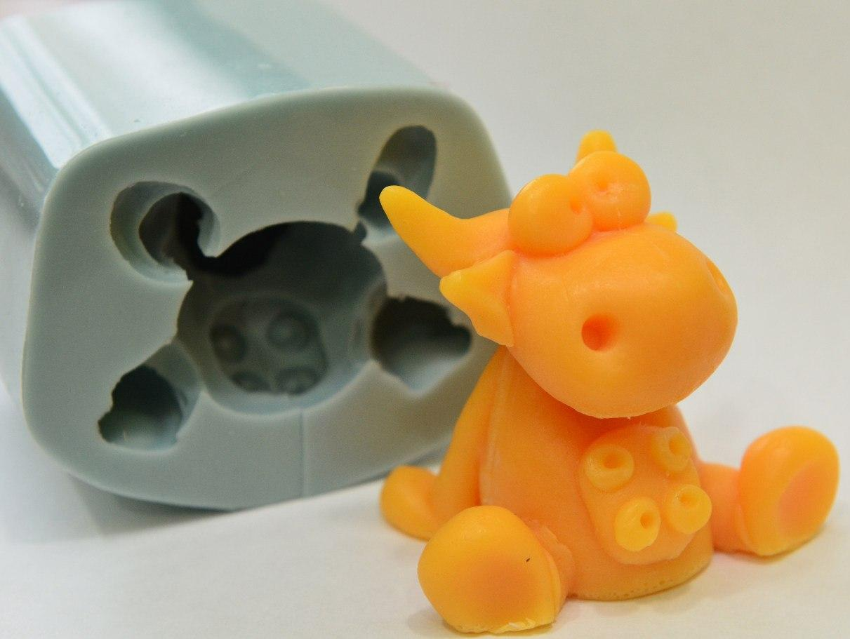
Objective forms of presentation of works
Writing
Oral
Sound or video recording
Picture
Space-spatial

Slide 3
Objects of copyright
Literary works
Dramatic and musical dramatic works
Choreographic works and pantomimes
Musical works
Audiovisual works
Works of painting, sculpture, graphics, design, comics and other works of fine art
Works of Architecture, Urbanism and
Landscape Art
Works of arts, crafts and scenographic
Photographic works
Maps, plans, sketches and plastic works related to geography, topography and other sciences
Derivative works
Collections and other composite works, which are the result of creative work in the selection or arrangement of materials
Protection of rights extends to the form in which the work is presented, and not on its content!

Slide 4
Non-property rights
The authorship
Addressed
On the promulgation, including the right to recall
To protect the author's reputation
Property rights
To play
For distribution
On import
For public display
For public performance
To broadcast
For communication to the public by cable
For translation
For recycling

Slide 5


Copyright mark
It consists of three elements:
The Latin letter "C" in a circle;
The name of the holder of exclusive copyrights;
Year of the first publication of the work

Slide 6

Sign of protection of neighboring rights
It consists of three elements:
The Latin letter "P" in a circle;
The name of the owner of exclusive neighboring rights;
Year of the first publication of the phonogram.

Slide 7
The invention is a new and significant technical solution to the problem in any branch of the national economy, socio-cultural construction or defense of the country, which gives a positive effect
Invention
Device
Method
Substance
Strains of microorganisms

Slide 8
The device is a system of elements located in space, interacting with each other in a certain way.
The method is an invention consisting in the creation of new or improvement of known operations and techniques, a new order of alternation of known operations or techniques, new temperature or other modes, the use of new materials for this method, devices and tools and characterized by technological features.
A substance is a new, materially differentiated, artificially created material entity, which is an aggregate of interrelated elements, ingredients.

Slide 9
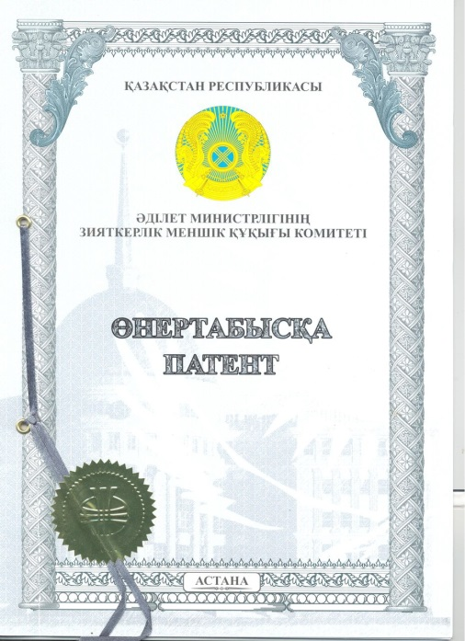
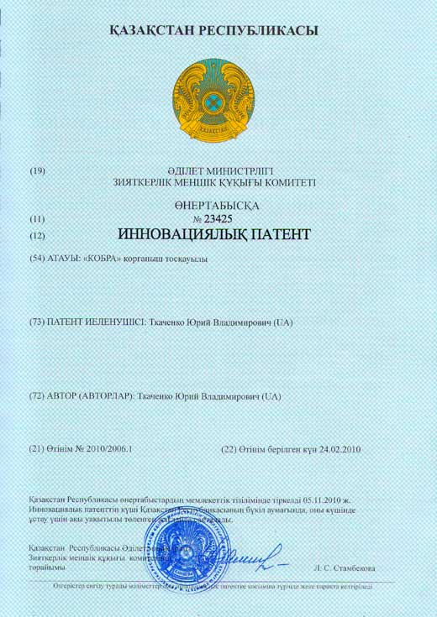
A patent is a certificate issued by a competent state body (certificate of protection) certifying the recognition of a technical solution or a breeding achievement by the invention, the priority of invention (primacy), authorship (not in all countries) and the patent owner's exclusive right to an invention within the territory of the issuing state within term established by the legislation of this state.

Slide 10
Criteria for patentability
Innovation should be:
New
Unobvious
Applicable in production

Slide 11
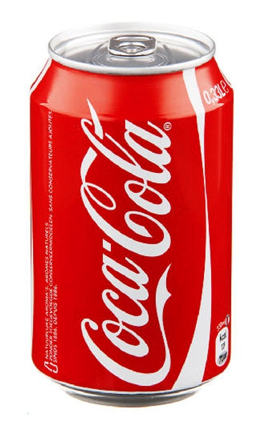

Know-how - unprotected by protection documents and not published in whole or in part knowledge or experience of scientific, technical, industrial, managerial, commercial, financial or other nature that are applicable in scientific research, development, manufacture, sale and operation of competitive products.

Slide 12
Kinds
know-how
Inseparable from the individual
Inseparable from the enterprise
Separated

Slide 13
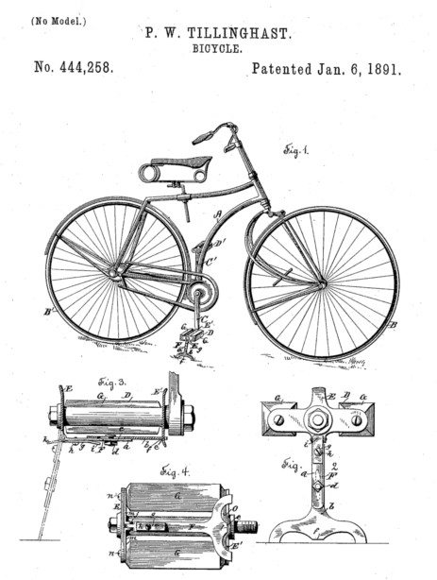
A useful model is the constructive implementation of the means of production and consumer goods, as well as their constituent parts.
A useful model is a new solution of a technical problem related to a device.

Slide 14
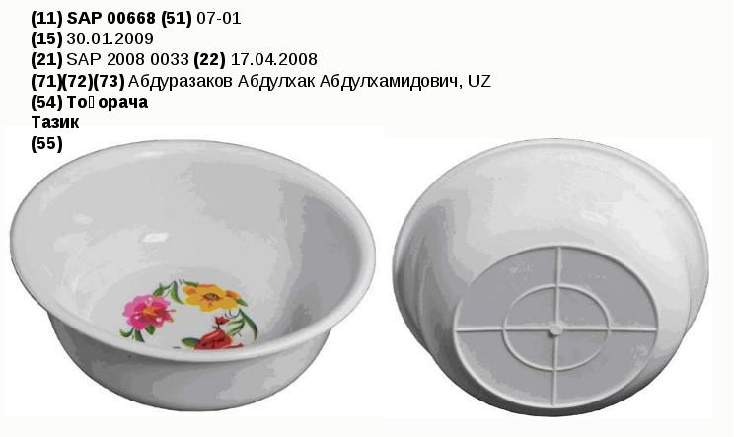
An industrial design is the artistic design solution of a product of industrial or handicraft and handicraft production, which determines its appearance

Slide 15
Types of industrial designs
Volumetric Example: the appearance of the chair, car, telephone.
Planar Example: the appearance of the carpet, headscarf, tie, fabric.
Combined Example: the appearance of the dishes on which the picture is made, shoes, packaging, construction finishing tiles

Slide 16
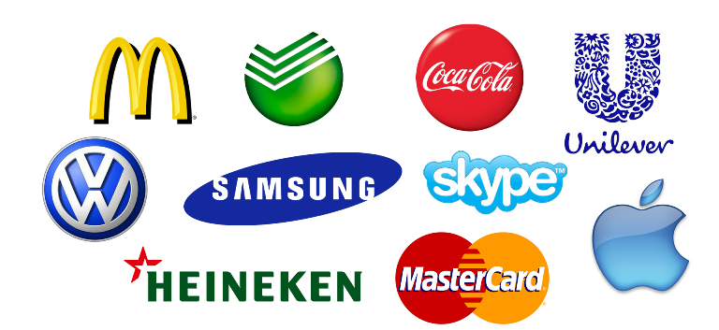
Trademark and service mark - these are symbols that are able to distinguish goods and services of certain legal entities or individuals from homogeneous goods and services of other legal entities and individuals.

Slide 17
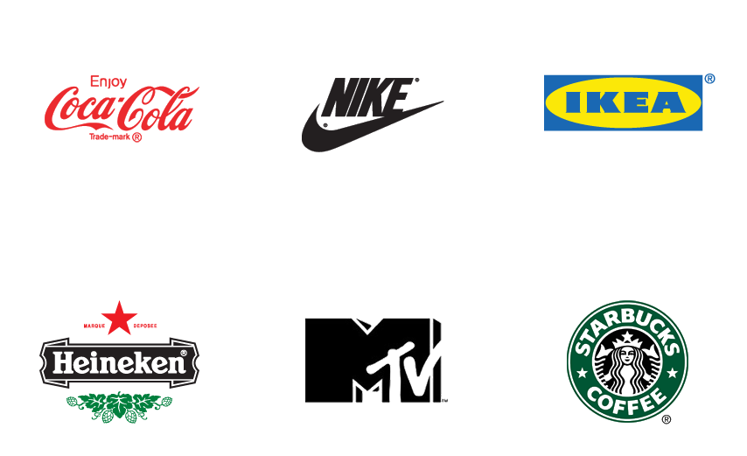
A brand name is the name of a legal entity that is an economic organization that allows individualizing a particular enterprise in civil circulation.

Slide 18

Scientific and technical products are the results of intellectual activity that have commercial value and are sold to the consumer mainly in non-material form (as a set of scientific and technical information).
The license agreement is the permission for the use by another legal entity or individual of an invention, technology, technical knowledge and production experience, secrets of production, trademark, commercial or other information for a certain period, within the limits stipulated by the agreement for an appropriate remuneration.

Slide 19
THANK YOU FOR ATTENTION!!!

